Slide 1
Users Group Annual Meeting
Hugh Montgomery
June 8, 2008

Slide 2
Outline
Laboratory Management Budgets The Laboratory Programs Conclusions

Slide 3
Laboratory Management
Provide the basis for laboratory physics operations
DOE Measures for 2008 Laboratory performance was excellent JSA Contract extended through 2013 ESH&Q 2008 performance has extended into 2009, we are on track to meet the goals in terms of keeping our people safe Strategic Plan presented to Office of Science in late April Steve Koonin, DOE Under-secretary for Science Bill Brinckman, Director Designate of the Office of Science

Slide 4
Facilities and Infrastructure Investments
Fully executed plan will put laboratory on track to meet modernization goals
 | 2009 | 2010 | 2011 | 2012 | 2013 | 2014 | 2015 | 2016 | 2017 | 2018 | 2019
Maintenance | 3.6 | 3.8 | 3.9 | 4.1 | 4.7 | 5.9 | 6.2 | 6.4 | 6.6 | 6.9 | 7.1
Deferred Maintenance Reduction | 0.4 | 0.2 | 0.2 | 0.2 | 7.3 | 2.8 | 0.2 | 0.2 | 0.2 | 0.2 | 0.2
GPP | 12.5 | 2 | 2.3 | 2.3 | 2.4 | 4 | 4 | 4 | 4 | 4 | 4
Line Items¹ | 13.5 | 38.7 | 35.4 | 29.3 | 23.8 | 28 | 24 | 0 | 0 | 0 | 0
Total Investment | 29.6 | 44.5 | 41.6 | 35.7 | 30.9 | 37.9 | 34.2 | 10.4 | 10.6 | 10.9 | 11.1
Estimated RPV | 331 | 351 | 388 | 402 | 470 | 497 | 519 | 541 | 559 | 579 | 599
Estimated DM | 11.1 | 11.5 | 11.9 | 12.3 | 5.4 | 2.8 | 2.9 | 3.0 | 3.1 | 3.2 | 3.3
Site-Wide ACI | 0.97 | 0.97 | 0.97 | 0.97 | 0.99 | 0.99 | 0.99 | 0.99 | 0.99 | 0.99 | 0.99
1. 12 GeV Conventional Facilities, TEDF, Utilities Modernization, and CEBAF Center Complex Addition/Upgrade
Plan to invest $46M in GPP through FY2019
Steady reduction in deferred maintenance through Laboratory and SC strategic investments
Line Item row includes $29M for 12 GeV construction and $163M for 3 SLI projects

Slide 5
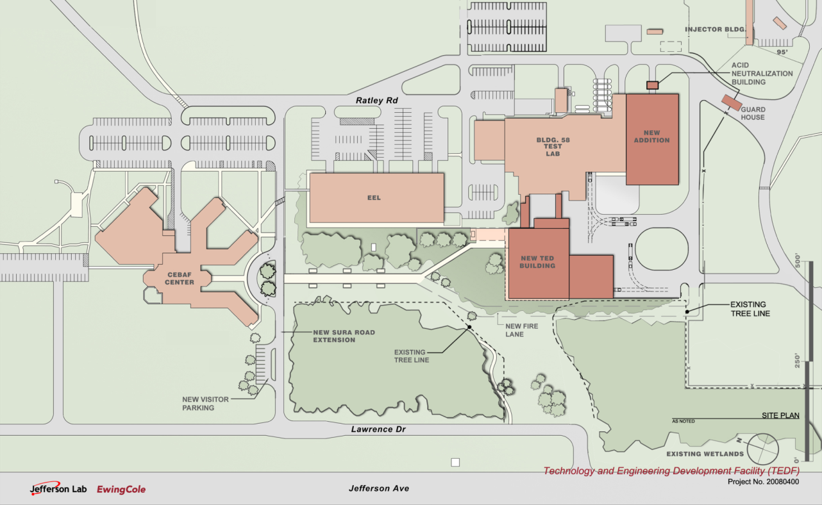
TEDF Project
Scope
  Construct 70K SF Technical Bldg
  Renovate Test Lab and add 30K SF technical/lab space
  Eliminate 22K SF space
Cost
  $72.2 M
  Funding Profile
    FY09 $3.7M PED
    FY10 $12.8M
    FY11 $16.3M
    FY12 $24.4M
    FY13 $15M

Slide 6
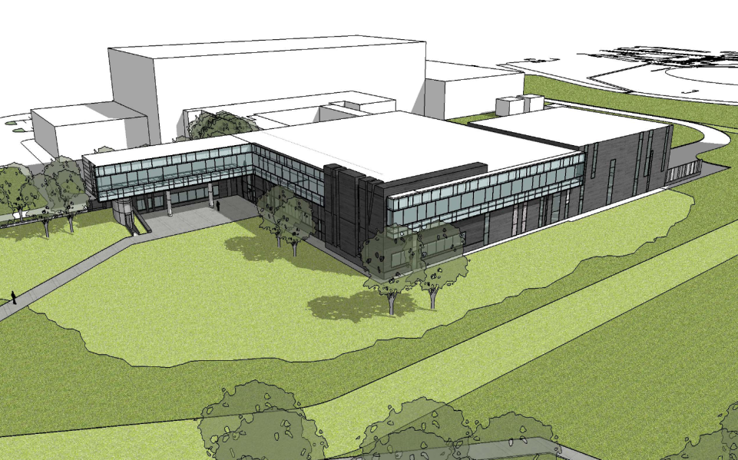
TEDF Project Status
Status
  Completed Advanced Conceptual Design
  Awaiting PED
Schedule
  CD-1 Sep 08 (complete)
  CD-2 Jul 09
  CD-3
    New construction 2nd Qtr FY 2010
    Rehab 4th Qtr FY 2012
  CD-4
    New construction 4th Qtr FY 2012
    Rehab 4th Qtr FY 2014
Can accelerate project completion to 4th Qtr FY 2012

Slide 7
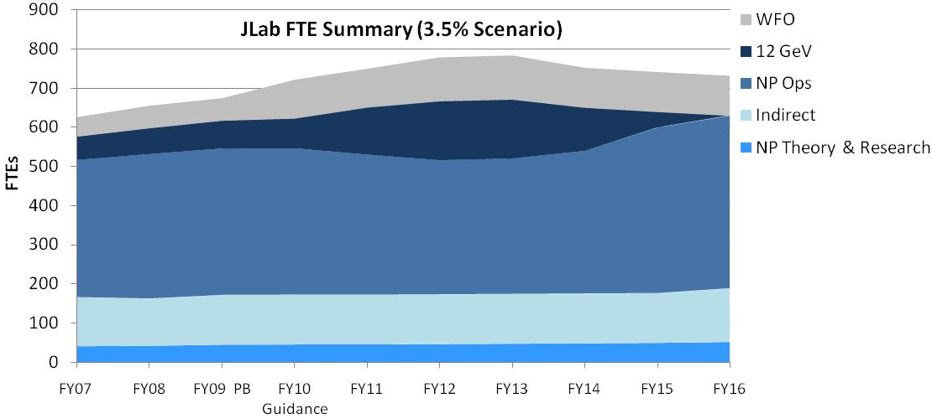
Financial Expectations and Workforce Trends
Workforce expands to support new scope in 12 GeV era
Assumptions:
Base Funding Increases at Least 3.5% Annually
Major Construction and Lab Modernization efforts are Maintained (12 GeV Upgrade, SLI, GPP)
Power Rate and Consumption Increases
FEL Funding Increases to Support Navy and EFRDC/BES Programs
Does Not Yet Include Future Work on FRIB, Project X or SNS PUP

Slide 8
Jefferson Laboratory Funding (Partial)
Funding (k$) | FY08 Appr | FY09 CR | FY09 Approp | FY09 ARRA | FY10 PB Revised
GPP ARRA |  |  |  | 10,000
AIP ARRA |  |  |  | 2,760
Subtotal NP Base | 80,331 | 79,845 | 88,509 | 12,760 | 95,044
12 GeV | 14,377 | 14,377 | 28,623 | 65,000 | 22,000
Subtotal NP Base & 12 GeV | 94,708 | 94,222 | 117,132 | 77,760 | 117,044
National LQCD Ops & CE | 110 | 110 | 380 | 4,965 | 1,180
SciDAC | 251 | 181 | 320 | 0 | 331
Total NP | 95,069 | 94,513 | 117,832 | 82,725 | 118,555
TEDF |  |  | 3,700 |  | 27,700

Slide 9
Major Activity
6 GeV Program
Complete the scientific exploitation of existing 6 GeV CEBAF
Outstanding physics remains that is best done utilizing the capabilities of the present CEBAF accelerator and its experimental equipment during the 3½ years remaining before the final Upgrade shutdown: Completion of data-taking for NP milestone-related physics HDIce, FROST, DVCS, SANE, and d₂^{n} Important new data on subjects ranging from strange quark distributions to N-N correlations Unique new experimental directions: PREx and Qweak Qweak Measure the Weak charge of the proton Factor of 5 increase in precision for weak charges of the quarks (C_{1u} and C_{1d}) Probes physics beyond the Standard Model from 2-5 TeV (potential for discovery) PREx Determine neutron distribution in ²⁰⁸Pb independent of model! Constrain equation of state for neutron stars Measurements in new areas of research that will be a focus of science with the 12 GeV Upgrade Single spin asymmetries, DVCS w/longitudinally polarized target, PVDIS, …..

Slide 10
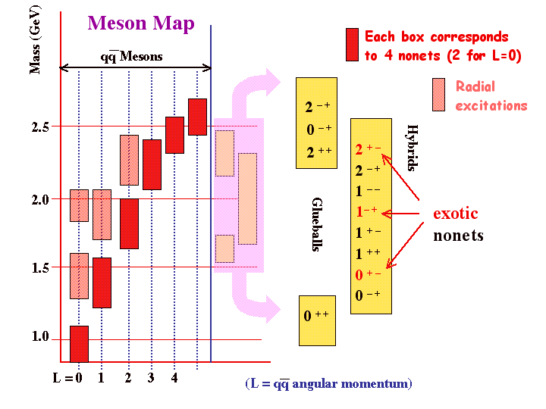
Major Activity
12 GeV Upgrade
Exciting new scientific opportunities – continue world leadership
Discover the spectrum and properties of exotic mesons in mass range 1.5-2.6 GeV in order to explore the physical origins of quark confinement Define the spin and flavor structure of the nucleon in the valence region, hence test theories of di-quarks, pQCD…. Determine the orbital angular momentum carried by up and down quarks and explore potential of Generalized Parton Distributions for tomographic imaging Exploit the unique capabilities of CEBAF at 12 GeV to explore the structure of nuclei at the level of quarks and gluons – understand the EMC effect Probe potential new physics (beyond the Standard Model) through precise test of evolution of sin² θ_{W} from Z-pole

Slide 11
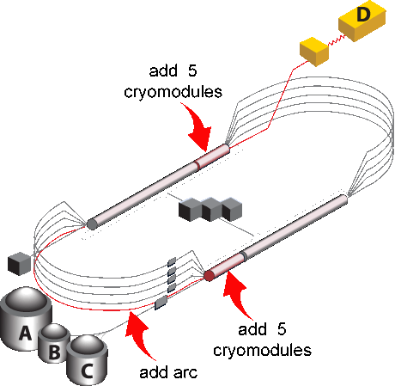
Major Activity
12 GeV Upgrade
Project execution proceeding apace
Total Project Cost $310M Upgrade accelerator and infrastructure to allow delivery of 11 GeV to three existing experimental halls and 12 GeV to a new hall Construct new hall and completely new, large scale experiment (GlueX) Upgrade equipment in other halls to permit exploitation of new energy range CD3, ready for construction, granted in September 2008, construction initiated in October 2008 FY2009 funding $28M, ARRA advancement of funding in 2009 of $65M Initial large procurements have already been awarded, including two large civil packages for the Central Helium Liquefier extension and for the Hall D construction Accelerator shutdowns 6 months in 2011 and 12 months in 2012, commissioning starts in 2013, CD4 in 2015

Slide 12
Major Activity:
ELectron Ion Collider Physics (ELIC)
Further extension of electron – nucleus scattering physics
Define the gluonic and quark spin-flavor structure of the nucleon sea – as 12 GeV will have done for the valence region Explore the nature of the very high density, universal gluon field at small Bjorken x Common effort to refine the science driving the plans for the facility with BNL, proponents of the CERN LHeC, and an international user community International efforts (OECD GSF Report/IUPAP WG.9) concerning funding mechanism ELIC design concept promises two orders of magnitude higher luminosity than eRHIC and LHeC designs R&D is essential if this is to be a truly world-leading facility

Slide 13
Major Activity
Superconducting RF Technology
World leading center for accelerator technology
Current activities include: Building upgrade cryounits for CEBAF@12 GeV (with 3 times the original CEBAF cryomodule performance) Refurbishing existing CEBAF cryomodules for improved performance Carrying out R&D aimed at reaching fundamental limits of SRF performance (e.g., large grain/ single crystal Nb) Leading the ILC global 9-cell high-gradient cavity processing program (a Jlab physicist is the new Group Leader) Our aim is to continue as SRF center of expertise for the Office of Science We are collaborating with every project in DOE 20 year plan that needs SRF, including FRIB, SNS-PUP, Project X, and the 4th Generation Light Source We have the capacity to participate in R&D for all of them We could handle cavity production for all projects, but not simultaneously Superconducting RF is (only) one of the accelerator core competencies which underpin much of the Office of Science program. These activities need a vibrant and coordinated R&D program aimed at development for the medium term (10 years) (as well as the very long term).

Slide 14
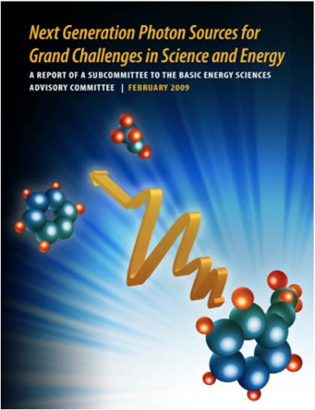
Major Activity
Light Source
Towards a Next Generation Photon Science Facility at Jefferson Lab
JLab operates one of two 4GLS in the US In the IR now (14 kW CW power and 150 fs pulse length) In the UV w/ planned CY2009 extensions A White paper under review documents a 3-step plan to leverage our technology base and dramatically improve US capability in VUV/soft X-ray generation for a modest investment, extending the JLab 4GLS FEL to high average brightness VUV/soft X-ray and mounting a serious user program: 3rd harmonic of the UV FEL will soon achieve VUV 100nm photons at an average brightness exceeding FLASH (& any other source in the world) and provide user capability An energy upgrade (to 300 MeV) by replacing cryomodules would reach 60nm in the fundamental and soft X-rays in the 3rd harmonic (Intensity would be many orders of magnitude higher than FLASH and pulse lengths would be <100 fs) Adding energy recirculation to reach 600 MeV would provide a 10nm fundamental with brightness exceeding any available source in the world This project would: Cost <$50M over 5 years Establish User program and address source and detection technology Address R&D goals identified in BESAC Report “Next Generation Photon Sources for Grand Challenges in Science and Energy”

Slide 15
Jefferson Laboratory Program
Core Capabilities and Activities Summary
Science and technology directions well defined and understood
Nuclear Science is the primary Jefferson Laboratory Mission The laboratory operates a renowned user facility with a large international user community The laboratory core competencies in accelerator science, particularly superconducting radiofrequency technology, energy recirculating linacs, and free electron lasers, make it a broadly sought partner in office of science projects Its technology has been widely applied Based on its technology, a strong photon science potential and a path to the next generation of X-ray source has emerged
Infrastructure in place and planned to support these directions fully
Physical Infrastructure Systems Infrastructure

Slide 16
Summary
The Present
We started the year cautiously; things worked out reasonably The supplementary support through the ARRA process, plus support for various ancillary initiatives has increased the internal tensions; resources immediately available are stretched The Physics is excellent and the challenges are worthy
The Future
It is imperative that the nuclear physics user community apply its strengths to the challenges… 6 GeV, 12 GeV, and ELIC

